Slide 1

Data Science Capstone Project
Team: Keras the Python
Obaro Agbanagba
Mustafizur Bhuiyan
Razvan Lungu
Tashlin Reddy
Jun Shao
Presentation 2: Initial Findings & Future Directions
Interventions of Fire Department in Montreal

Slide 2
Datasets
The datasets: fire department interventions, barracks, and census data from the Ville de Montreal were initially loaded and merged.
The census data of 2016/2011 included significant information such as language, age group, income bracket, and population per Montreal borough.
Theses attributes were assumed to be significant when merging dictionaries with the fire department dataset
Data cleaning measures were taken to filter unnecessary fields and assign primary keys

Slide 3
Data Cleaning
Initially Pandas dataframe was used to merge the datasets. Regarding keys, we used attributes such as {time} to concatenate the present and past interventions dataset, and {boroughs} for the merged dataset and census dataset.
Roughly about 500 NaN values associated to the datasets needed to be removed via python’s panda function:
(pd.dropna())

Slide 4
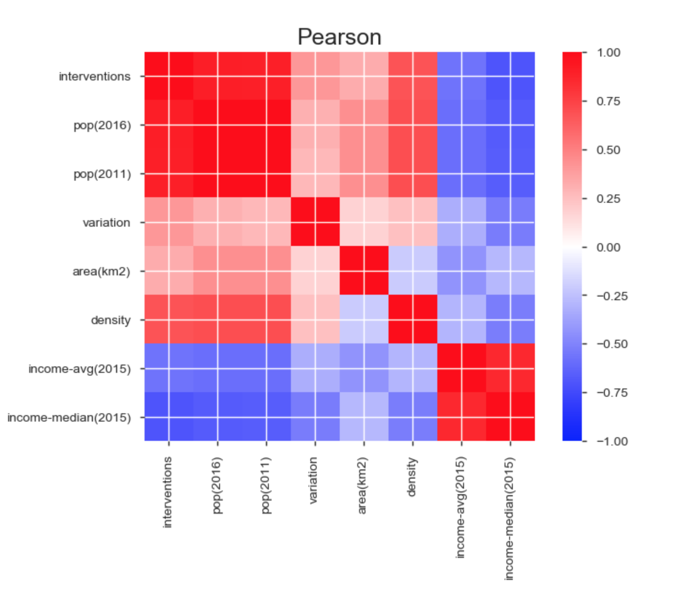
Correlations
Both Pearson and Spearman correlations were used to find relationships within the data.

Slide 5
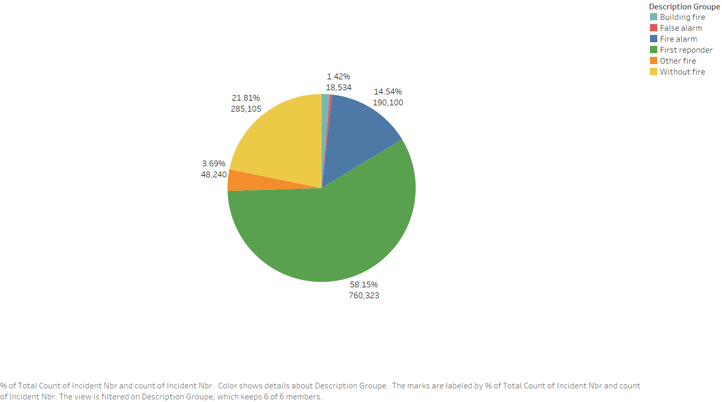
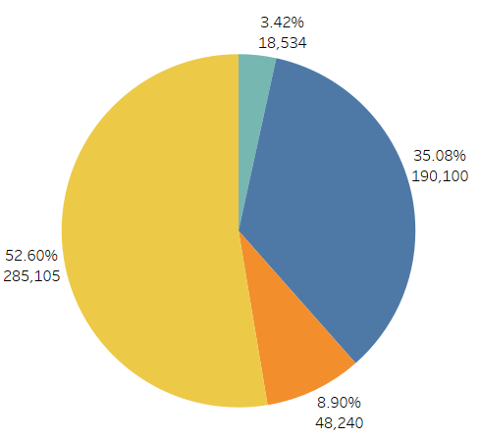
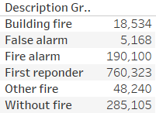
Initial Findings
Incidents Summary:
About 1,300,000 incidents in 31 districts of Montreal from 2005 to 2018.3
6 groups of incidents: First responder, Fire alarm, Building fire, Incident without fire, other fire, false alarm.
Percentage of each group of incidents
Without First responder and False alarm.

Slide 6
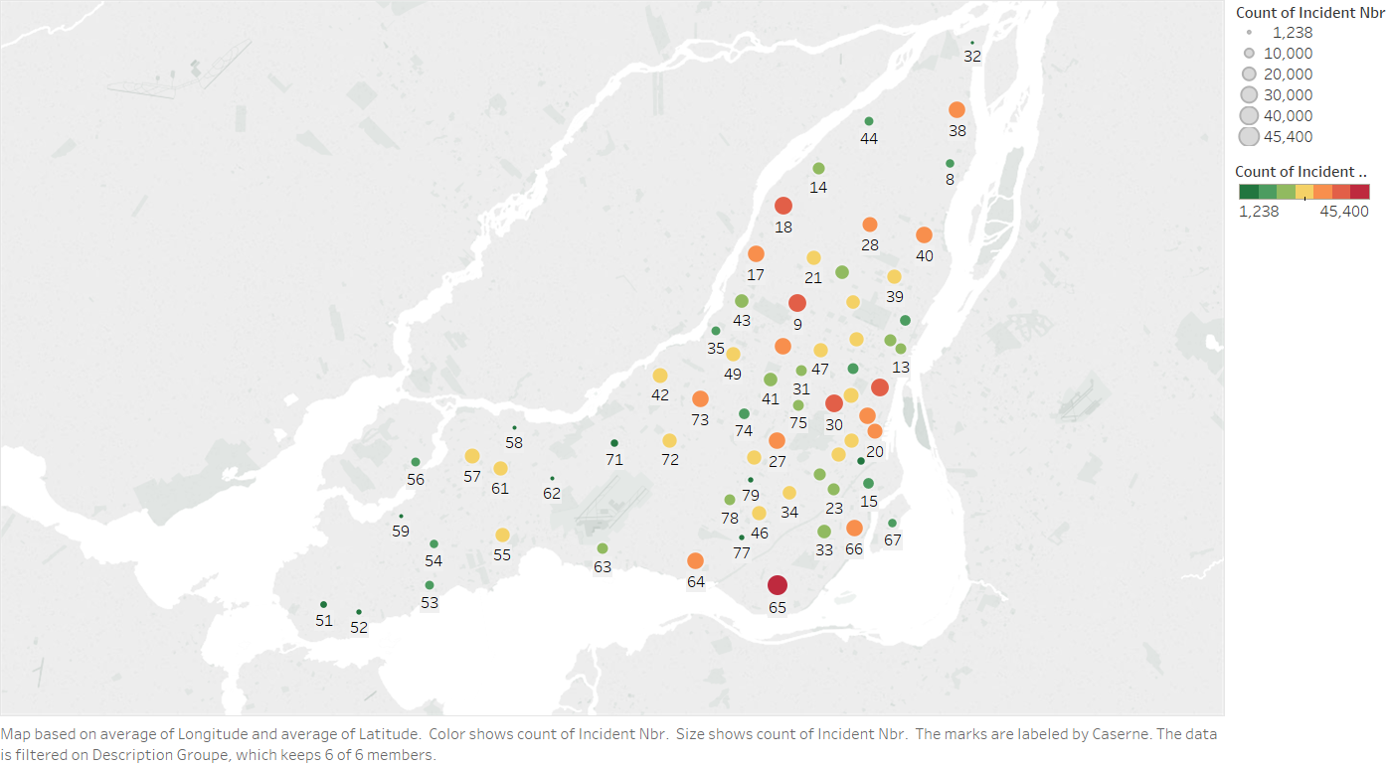
Initial Findings
Rank incidents number for each fire station.
# 65, #30,#18,#9,#19 are top five fire stations with highest count of incidents

Slide 7
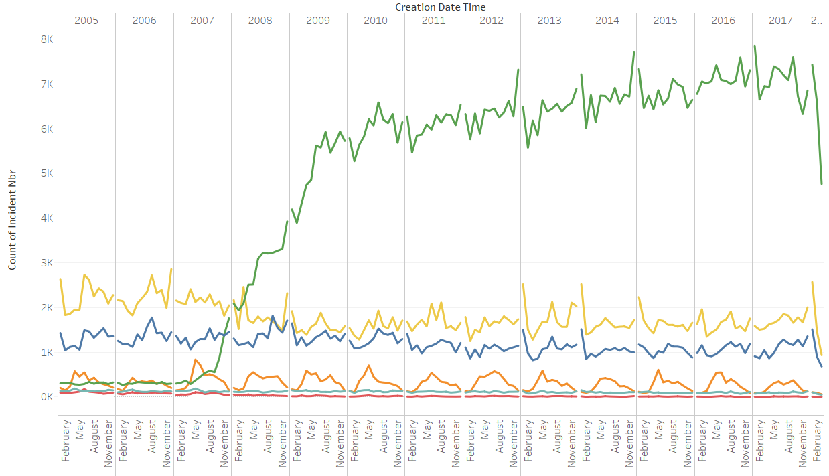
Initial Findings contd.
The level of without fire, fire alarm, other fire, building fire is stable during this period.
There is a dramatic rise for first responder from 2007 to 2009.

Slide 8
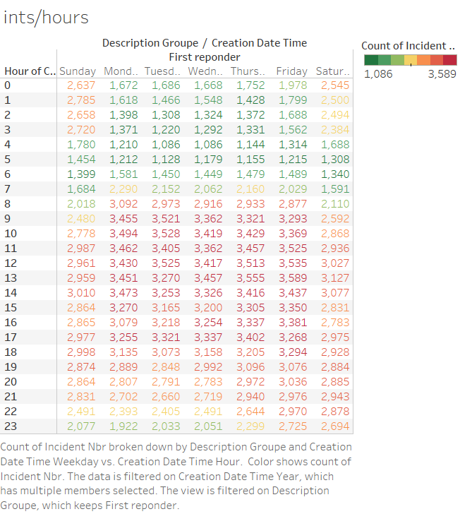
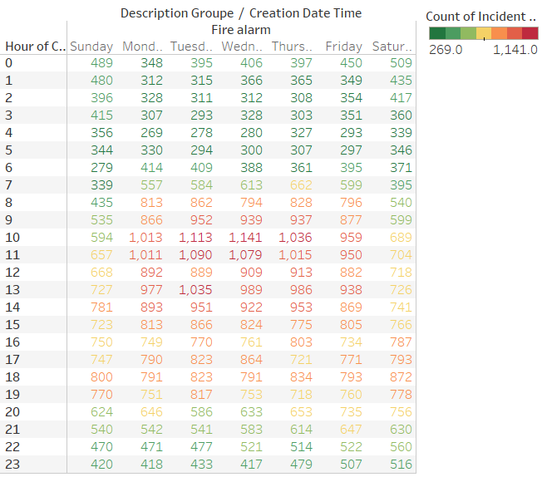
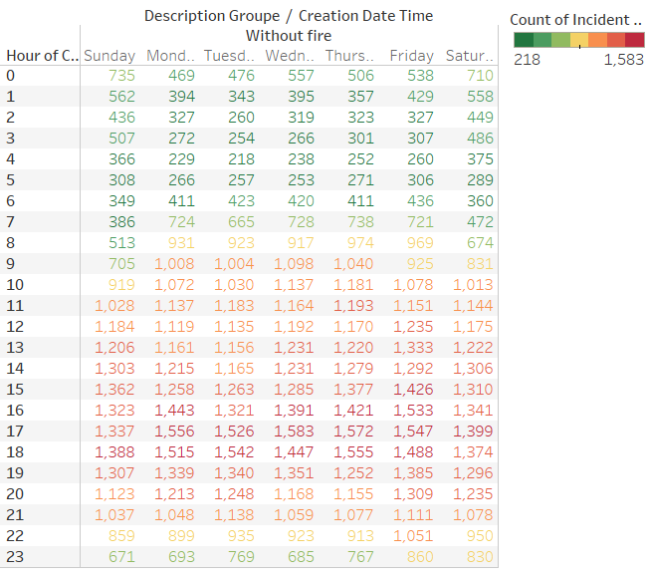
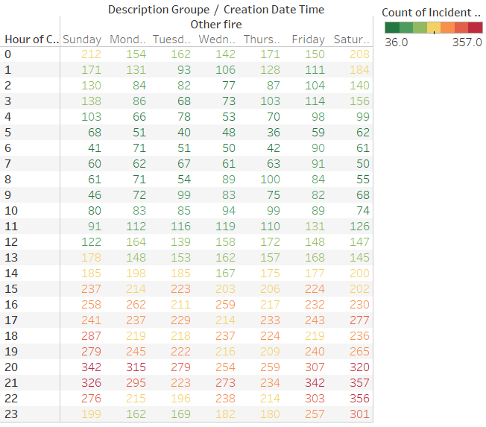
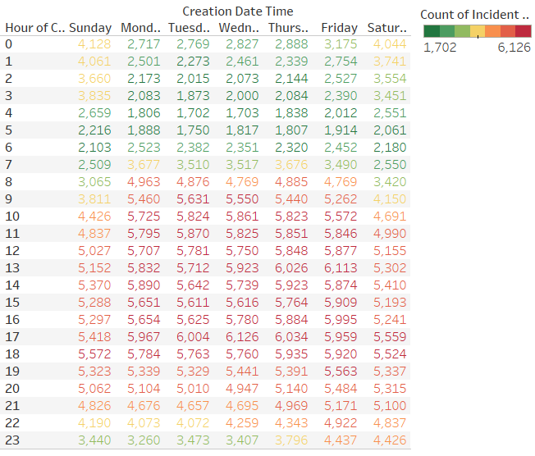
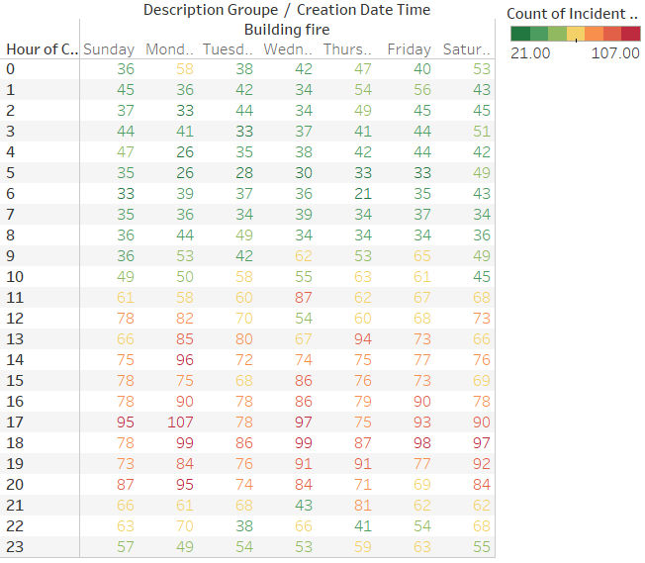
Initial Findings contd.
Left graphs display that the time 10:00 ~ 22:00 is the high frequent period for total incidents, Building fire, first responder and without fire.
10:00-20:00 fire alarm.15:00~22:00 other fire.
17:00 is the bust hour for fire fighters.

Slide 9
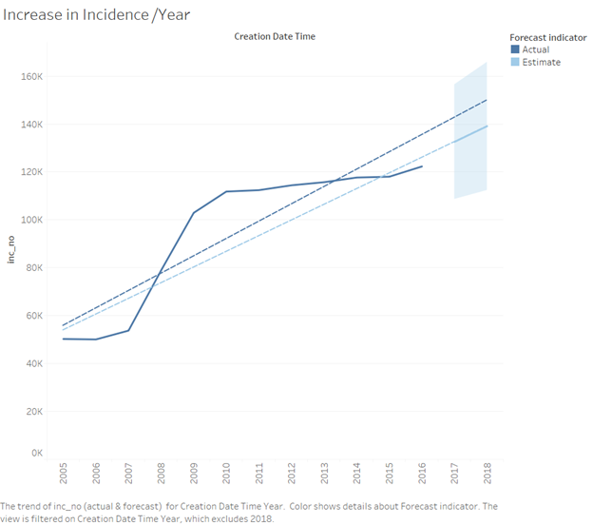
Initial Findings contd.

Slide 10
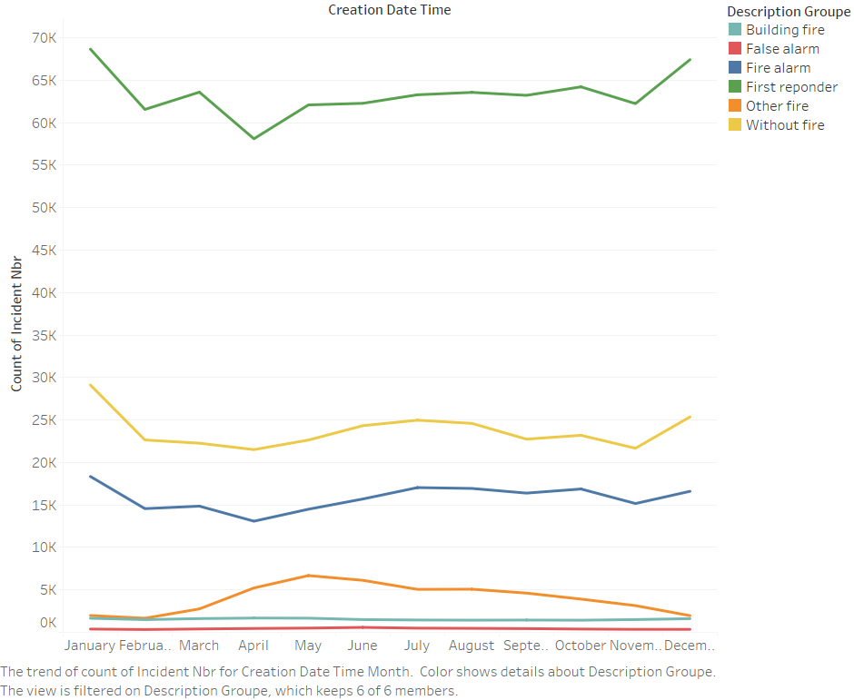
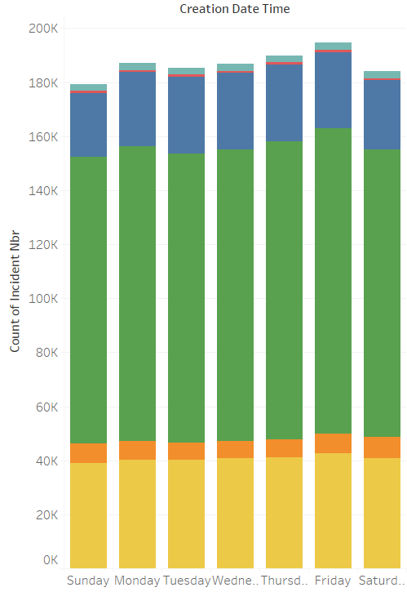
Initial Findings contd.
The graph below displays that December and January are months for higher frequency of incidents.
Additionally, Friday seems to be the most popular day of the week for firefighter intervention.

Slide 11
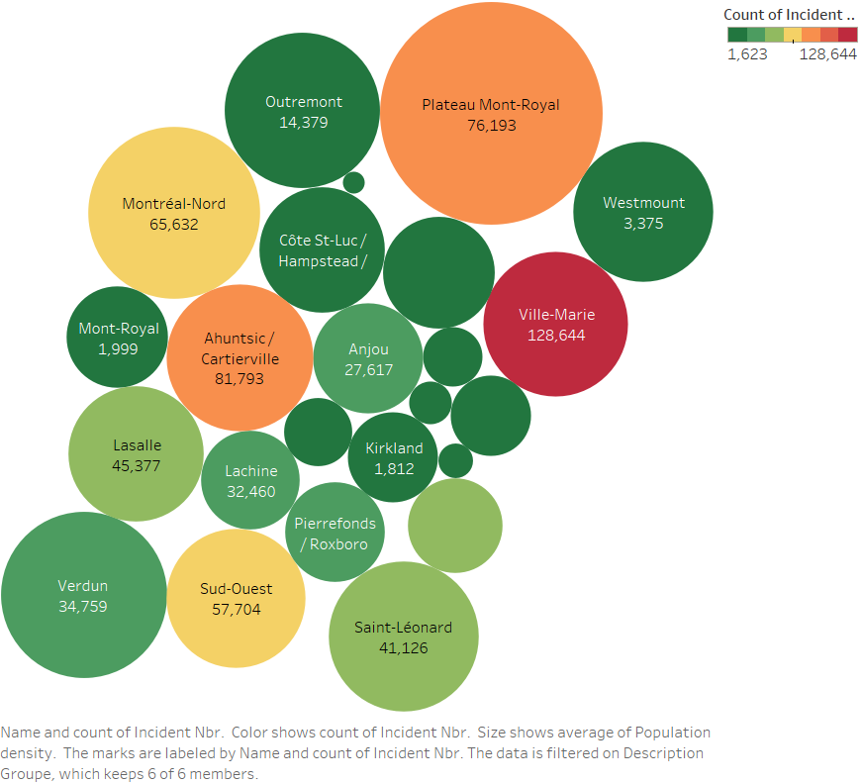
Initial Findings contd.
Once we added the census population density data, we can analyze the interventions/pop. density. The downtown area had the most number of incidents because of its population density
Highest population density
Highest incidents

Slide 12
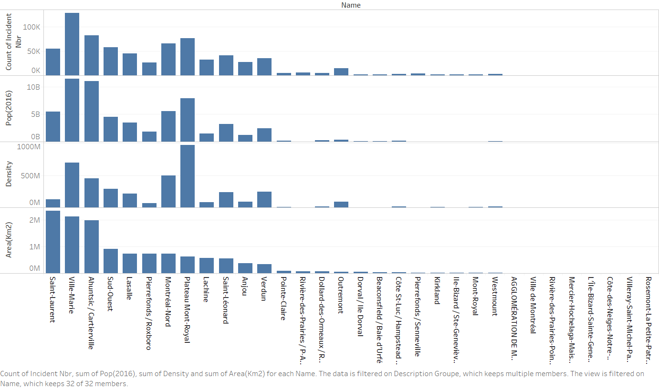
Initial Findings contd.
The graphs below depict elaborate further on the number of incidents per borough. the top three boroughs that experience the most interventions are Ville-Marie, Ahuntsic and Plateau-Mont-Royal. Amongst the three, Ville-Marie has the most square footage of area but Plateau has the most population per square area.

Slide 13
Initial Findings contd.
The graphs below depict elaborate further on the number of incidents per borough. the top three boroughs that experience the most interventions are Ville-Marie, Ahuntsic and Plateau-Mont-Royal. Amongst the three, Ville-Marie has the most square footage of area but Plateau has the most population per square area.

Slide 14
Next Steps for the Project
how can we model our data for prediction modelling?
What is the appropriate prediction model we can use?
Other research tried to:
predict the number of incidents
predict where future emergencies might occur, and of what type,
predict number of incidents that each fire station has to address
predict number of trucks needed at each incident

Slide 15
Next Steps for the Project
Our Goal
Predict change in number of incidents per borough over time
What is the appropriate prediction model we can use?
recurrent neural networks
Decision Trees
k-means clustering
Generalized linear model

Slide 16
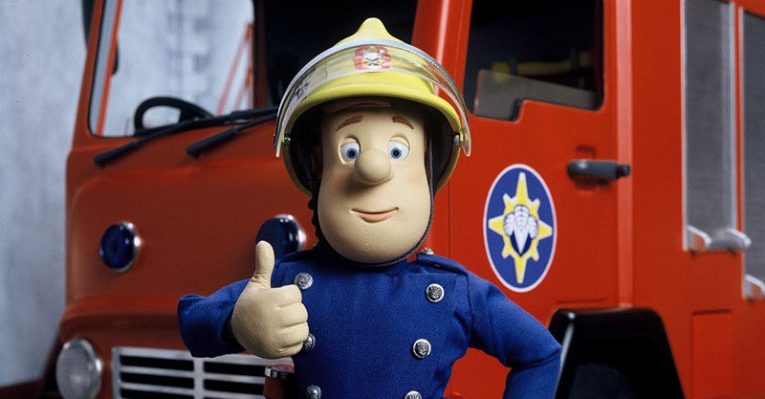
Thank You Questions?

